Slide 1
Does mitigating ML’s impact disparity require treatment disparity?
Yijun Liu
Department of Computer Science
University of Wyoming
Lipton, Zachary, Julian McAuley, and Alexandra Chouldechova. "Does mitigating ML's impact disparity require treatment disparity?." Advances in Neural Information Processing Systems. 2018.

Slide 2
Introduction
Background
Disparate treatment and Disparate impact
Question of premise
Disparate Learning Processes
Theoretical Analysis
Direct treatment disparity
X fully encodes Z
X only partially encodes Z
Empirical Analysis
Synthetic data example: work experience and hair length in hiring
Case study: Gender bias in CS graduate admissions
Comparison with Treatment Disparity

Slide 3

Background
Effective decision-making requires decision-makers to distinguish between options given the available features.
Laws in many countries restrict the ways in which certain decisions can be made. (Title VII of the Civil Rights Act of 1964) which Forbids employment decisions that discriminate on the basis of the protected characteristics

Slide 4
Disparate treatment and Disparate impact
Disparate treatment:
(i) decisions explicitly based on a protected characteristic;
(ii) intentional discrimination via proxy variables.
For example, in the 1900s, literacy tests for voting eligibility were employed to disenfranchise racial minorities.
Impact disparity:
when outcomes differ across subgroups, even if the correlation arises unintentionally.

Slide 5
Question of premise
DLPs are methods for simultaneously satisfying treatment and impact-parity criteria¹
DLPs : The protected characteristic may be used during training, but is not available to the model at prediction time.
Premise into question on the following grounds:
1. If protected characteristics are redundantly encoded in the other features, DLPs can (indirectly) implement treatment disparity.
2. Partially encoded DLPs induce within-class discrimination based on irrelevant features
3. DLPs provide a suboptimal trade-off between accuracy and impact parity. The optimal way to trade off the two is to apply per-group thresholds
1.Pedreshi et al., 2008, Kamishima et al., 2011, Zafar et al., 2017a

Slide 6
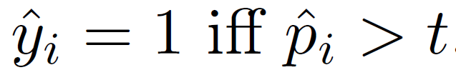
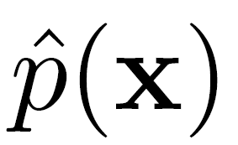
Disparate Learning Processes
This paper considers probabilistic classifiers
of the conditional probability P(y = 1 | x) of the label given a feature vector x
Measures of impact disparity the Calders-Verwer gap and the p-% rule.
n and z means number of samples and protected feature respectively.

Slide 7
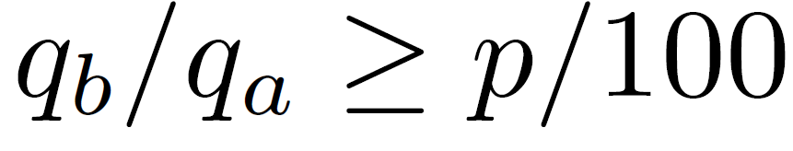

Disparate Learning Processes
The p-% rule, a classification is said to satisfy the p-% rule if
Formally, a DLP is a learning algorithm described by the following mapping:

Slide 8
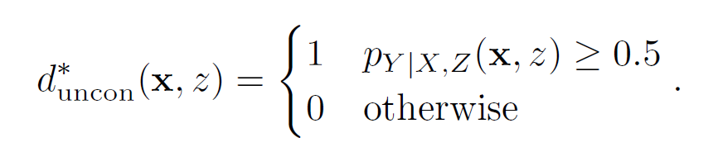
Direct treatment disparity
Treatment disparity is optimal absent impact parity constraints, the Bayes-optimal decision rule for minimizing expected 0 -1 loss is given by

Slide 9
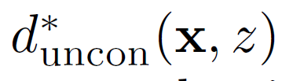

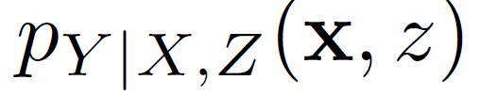

Direct treatment disparity
These rules can be thought of as operaated in the following mechanism:
Suppose that we start with the classifications of the unconstrained rule
and this results in a CV gap of
To reduce the CV gap to we have two mechanisms: We can
(i) flip predictions from 0 to 1 in group b, The optimal strategy is to perform these flips on group b cases that have the highest value of
(ii) we can flip predictions from 1 to 0 in group a.
Group a cases that have the lowest value of

Slide 10
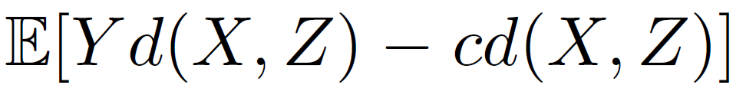
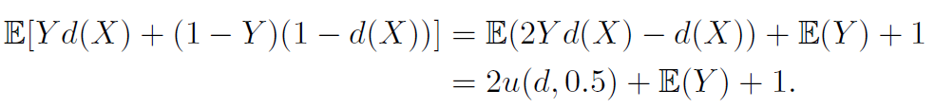
Direct treatment disparity
Following Corbett-Davies et al. [2017], who establish optimal decision rules d under different kinds of fairness-related constraints.
Lemma 1. Optimizing classification accuracy is equivalent to optimizing immediate utility with c = 0.5.
Immediate utility u(d, c) =
for (0 < c < 1)
Accuracy：

Slide 11
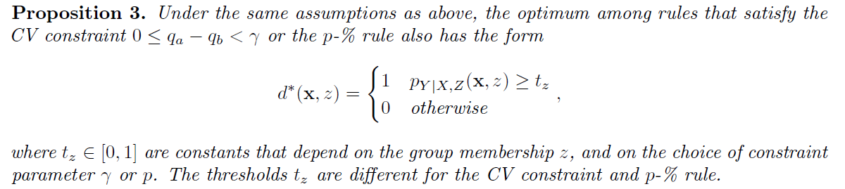
Direct treatment disparity

Slide 12

Direct treatment disparity
As shown in Corbett-Davies et al. [2017], we can rewrite the immediate utility as
It shows that a decision rule that does not directly use z as an input variable or for determining the thresholds will have lower probability than the optimal rule that uses this information for d = 1.
The DLP solution results in lower or equal accuracy

Slide 13
X fully encodes Z
Consider the case where the protected feature z is redundantly encoded in the other features x. More precisely, suppose that there exists a known subcomputation g such that z = g(x). This allows for any function of the data f(x, z) to be represented as a function of x alone via ~ f(x) = f(x, g(x)).

Slide 14
X only partially encodes Z
When the protected characteristic is partially encoded in the other features, disparate treatment may induce within-class discrimination by applying the benefit of the affirmative action unevenly, and can even harm some members of the protected class.
It will be proved in the following experment.

Slide 15
Synthetic data example: work experience and hair length in hiring
we sample n_{all} = 2000 total observations.
70% of the observations are used for training.
The remaining 30% are reserved for model testing.
key properties:
(i) the historical hiring process was based solely on the number of years of work experience;
(ii) because women on average have fewer years of work experience than men (5 years vs. 11), men have been hired at a much higher rate than women;
(iii) women have longer hair than men, a fact that was irrelevant to historical hiring practice.

Slide 16
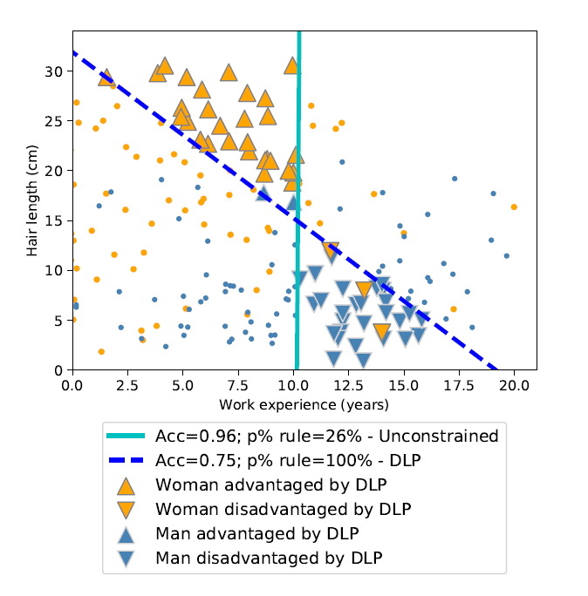
Synthetic data example: work experience and hair length in hiring
The DLP harms some of the most qualified individuals in the protected group. Group parity is achieved at the cost of individual unfairness.
Figure 1 shows the test set results of applying a DLP to the available historical data to equalize hiring rates between men and women.

Slide 17
Case study: Gender bias in CS graduate admissions
We consider a sample of 9,000 students considered for admission over an 11-year period 2006-2016.
Based on a superficial analysis, we did not observe any gender bias (the admissions rates for male and female applicants are within 1% of each other). So, to demonstrate the effects of DLPs, we corrupt the data with synthetic discrimination.
Of all women who were admitted, i.e., z_{i} = b; y_{i} = 1, we flip 25% of those labels to 0

Slide 18
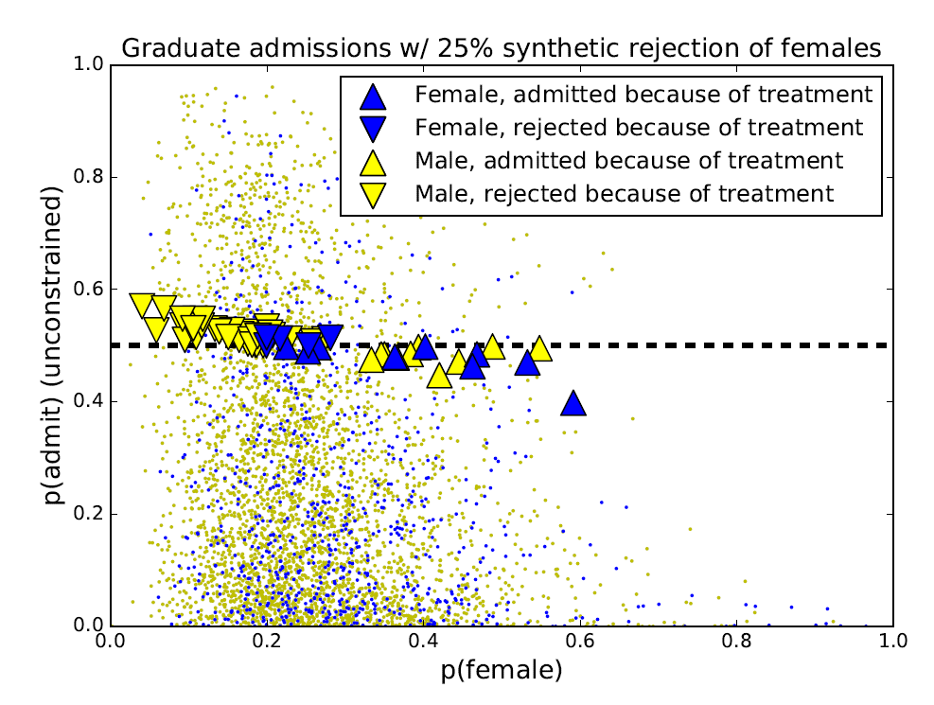
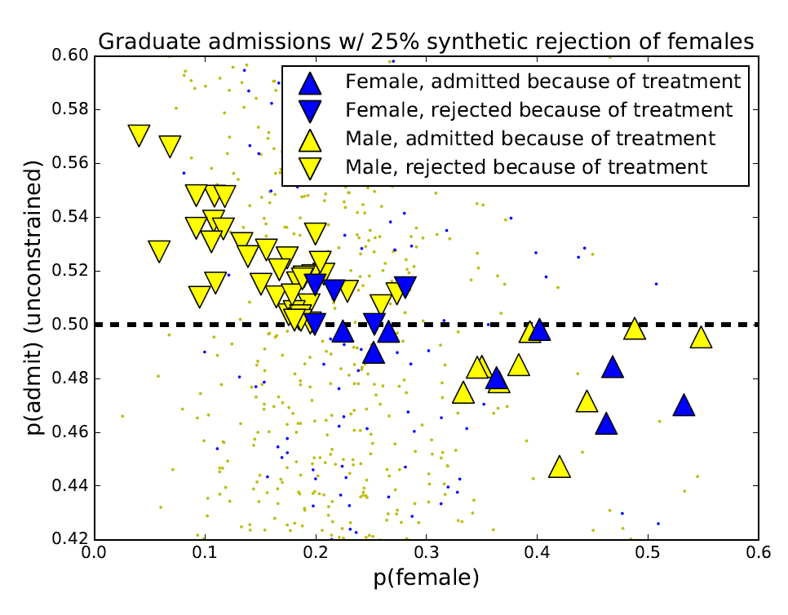
Case study: Gender bias in CS graduate admissions
Figure 2 shows the test set results of applying a DLP to the available historical data to equalize hiring rates between men and women. the DLP both disrupts the within-group ordering and disadvantage some women who, would have been admitted.

Slide 19
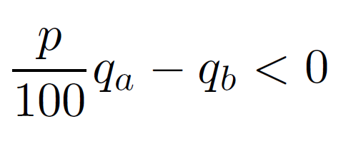
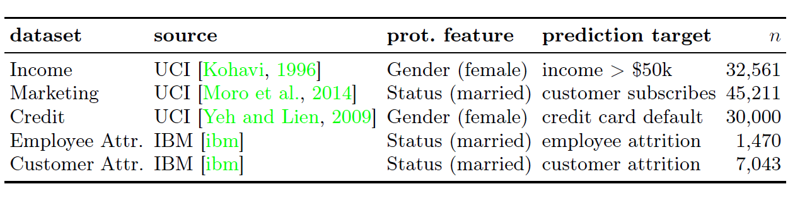
Comparison with Treatment Disparity
We can rewrite this as:

Slide 20
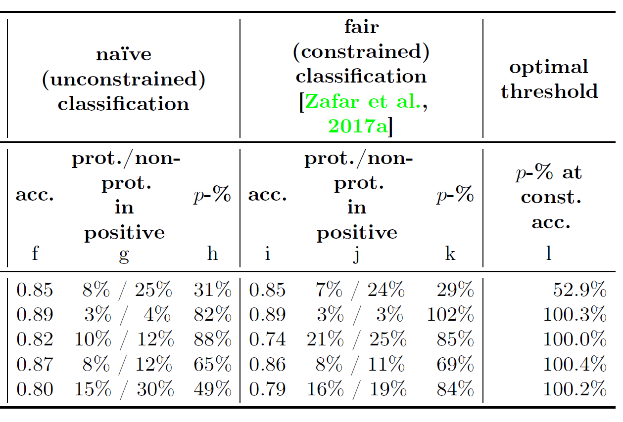
Comparison with Treatment Disparity
Optimal threshold (Treatment Disparity) gets better result.

